Slide 1

Martie santos
EXPERIENCE
30+YEARS HUMAN RESOURCE MANAGEMENT
UNIVERSITY OF CALIFORNIA SAN FRANCISCO (UCSF) RETIREE
31 YEARS OF SERVICE
EDUCATION
UNIVERSITY OF SAN FRANCISCO
BA POLITICAL SCIENCE
MASTER IN PUBLIC ADMINISTRATION (MPA)

Slide 2


Human initiative (hi)
& artificial intelligence (ai)

Slide 3
human initiative & artificial intelligence
Human Initiative is proactive, self-guidance, action taken to problem solve or to contribute positivity to a situation.
Artificial Intelligence is a section of computer science focusing primarily on building machines to complete tasks that normally require human participation for completion.

Slide 4
AddendUm: PROFESSION vs vocation
Profession / Job: a field of work defined by specialized knowledge, formal education or certification, ethical standards, and collective regulation (examples: medicine, law, engineering). Emphasis: expertise, autonomy, duty, credentialing.
Vocation: is an occupation to which a person is especially drawn or for which they are suited, trained, or qualified. Although the term is now often used in non-religious contexts and is related to cultivating motivated, self-directed, and positively engaged individuals within organizations, its meaning originally emerged within Christianity. A calling that can align with your everyday work or be pursued through volunteering, community engagement, and personal roles.

Slide 5
Professional AND PERSONAL context
Proactivity and Self-Starting: Taking initiative means starting tasks, making decisions, and providing solutions on your own, especially in a work or team setting.
Going Above and Beyond: It involves going beyond assigned tasks to improve processes or help others, showing a "go-getter" attitude.
Anticipating Needs: Identifying problems before they occur and preparing solutions in advance.
Self-Management: Developing personal responsibility and the ability to work independently.

Slide 6
Professional AND PERSONAL context
Experiences
Transition from STAFF Human Resource Management to ACADEMIC Human Resource Management
Prospective Faculty Hires Residing in Different Time Zones
Guiding/Training Faculty in Employee Management
Staff Acknowledgement - Theresa Ward
Introduction to Personnel Profession via Kay Kalmbach
Clotilde Gould, Guamanian Association of the Bay Area:
Miss Guam SF Bay Area

Slide 7
Professional and personal context experience
From: "Schreibman, Carroll" <Carroll.Schreibman@ucsf.edu>
Date: Friday, July 1, 2016 at 8:50 PM
To: "Santos, Martie" <SantosM@ucsf.edu>
Subject: Re: FY 2016-2017 Salary Program
Addendum:
The faculty are not easily impressed and have never been willingly “managed” better….I’ve not seen this level of respect and admiration from faculty for admin manager! Your relatability to all manner/make faculty appears seamless and is truly astounding. You can consider your transition out of your 22 years Staff HR comfort zone to Academic HR an unmitigated success! I realize it wasn’t easy knowing your learning curve would be high and mistakes awaited you, yet you exhibited courage and grace. And as we’ve discussed, it turns out, THIS, Academic HR, turns out to be your true niche!
cjs

Slide 8
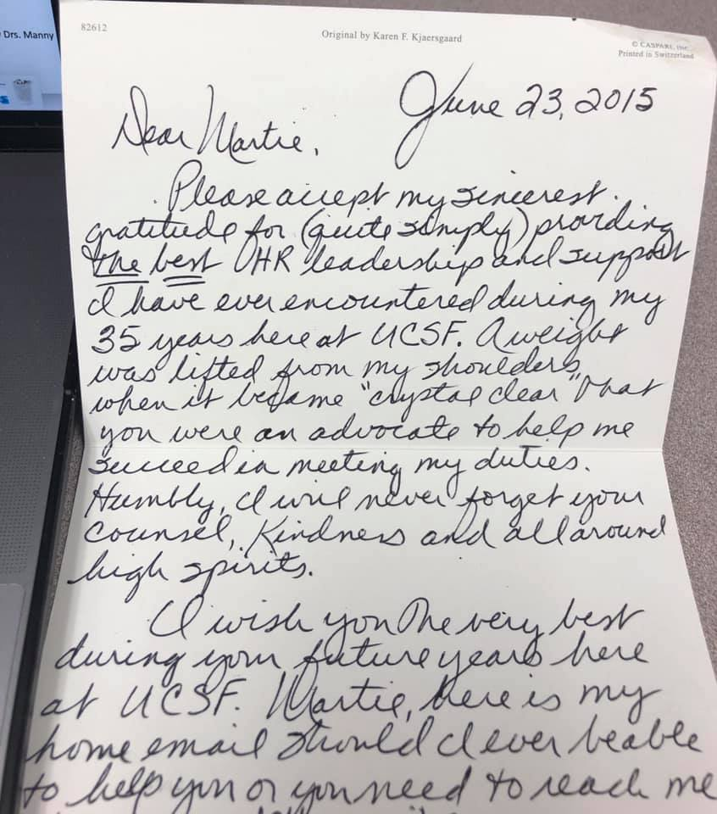
Professional and personal context experience

Slide 9
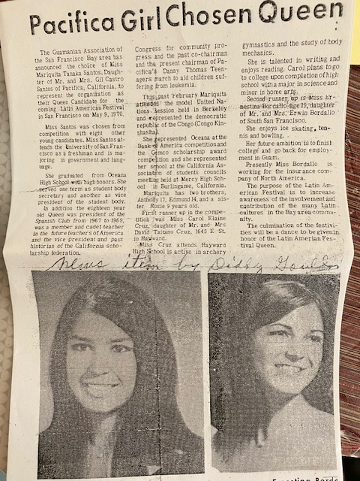
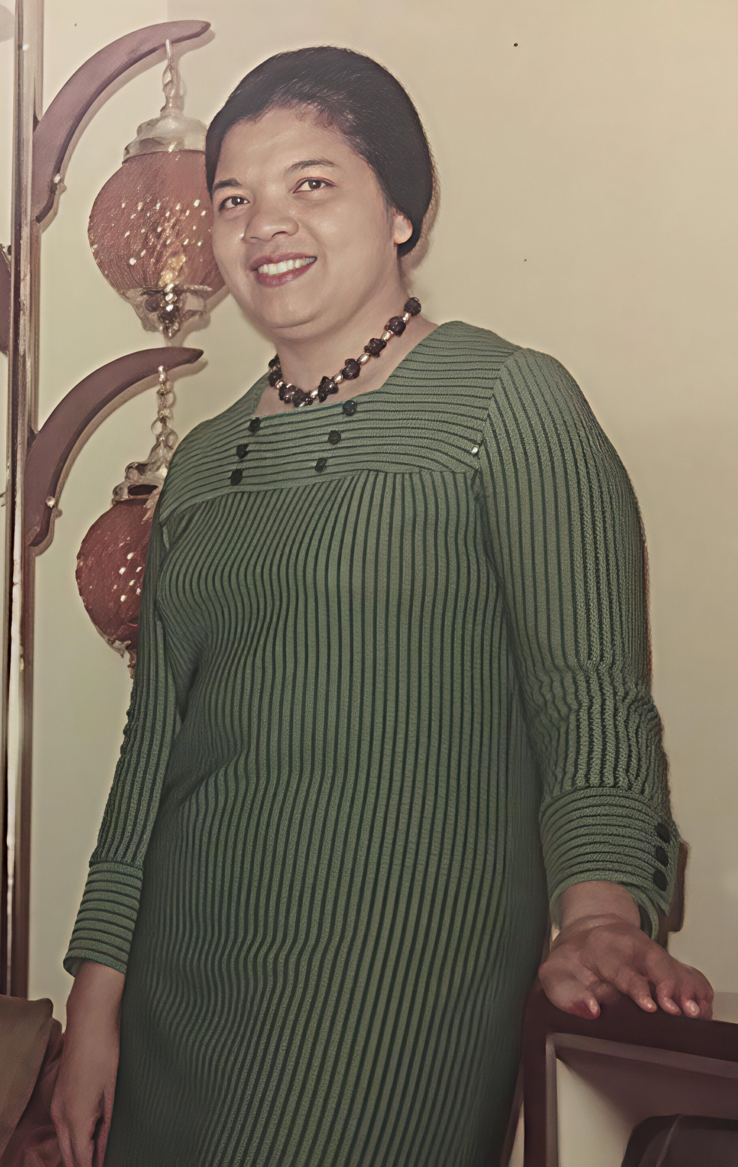
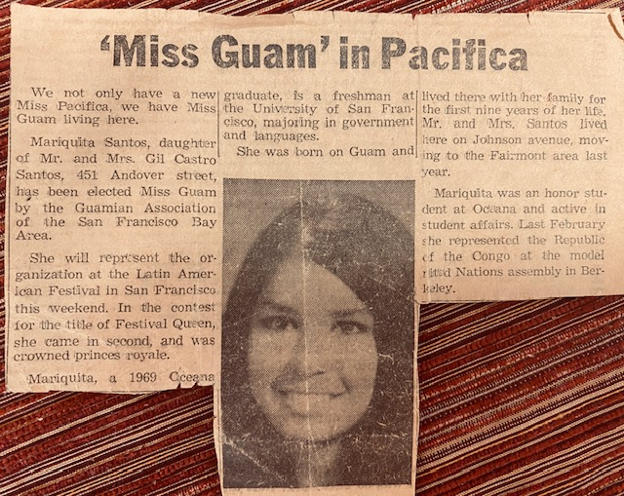
Clotilde Gould, Guamanian Association of the Bay ARea

Slide 10
CONCEPTUAL AND PHILOSOPHICAL CONTEXT
Subjective Initiative: Often used in philosophical contexts to mean a person’s ability to purposefully act upon the world to transform it.
Freedom of Action: It is considered an expression of human freedom, whereby a person moves from a state of reacting to their environment to one of actively controlling their own behavior to reach a goal.

Slide 11
CONCEPTUAL AND PHILOSOPHICAL CONTEXT
Experiences
Anesthesiologist reaction to Admin. Support
OR Workroom
Union Representative
Activism: DEI, Affirmative Action

Slide 12
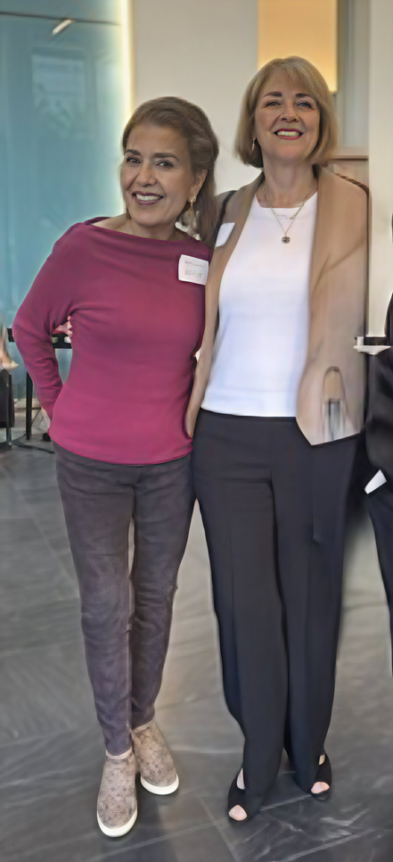
anesthesiologist reaction to admin. support

Slide 13
Or workroom
From: Collins, Adam Sent: Friday, February 1, 2002 4:48 PM
To: O'Halloran, Marge Cc: Carlisle, Sue MD
Subject: Martie Santos
Dear Marge,
I would like to thank you for your assistance in improving our HR situation in the San Francisco General Hospital anesthesia workroom. Martie Santos has worked tirelessly on this project for the past 4-5 months, and the results are starting to show. We now have an excellent lead anesthesia tech, and multiple experienced employees who work together to provide us with the competent and fantastic anesthesia support service, which we have historically had. Morale is much better already, and I believe that Martie should be commended for her excellent and dedicated work, much of which was done while she was on vacation. Is there any HR award for which I can nominate Martie.
Thank You,
Adam B. Collins MD
UCSF Department of Anesthesia and Perioperative Care, San Francisco General Hospital

Slide 14

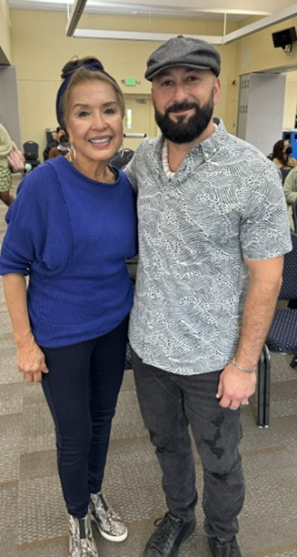
ACTIVISM: DEI, AFFIRMATIVE ACTION

Slide 15
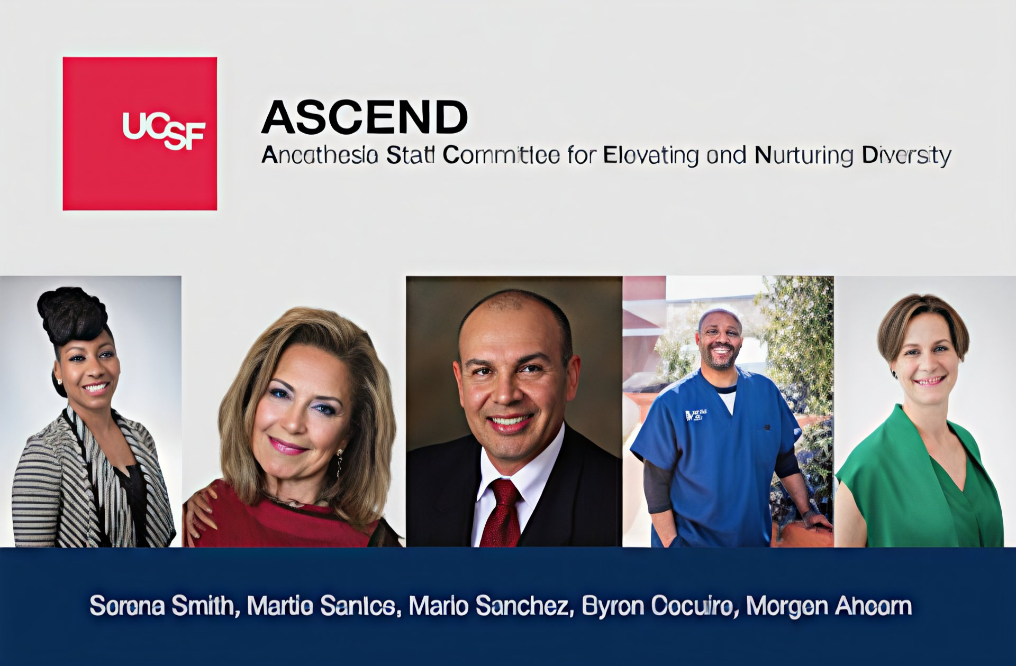
ACTIVISM: DEI, AFFIRMATIVE ACTION
Anesthesia Staff Committee for Elevating and Nurturing Diversity

Slide 16
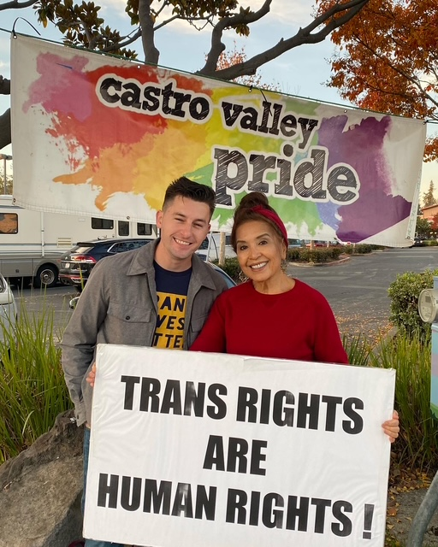
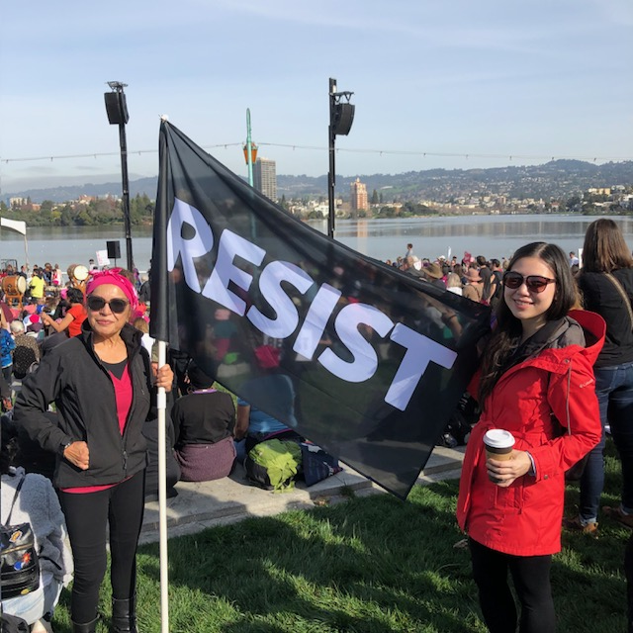

ACTIVISM: DEI, AFFIRMATIVE ACTION

Slide 17
HUMANITARIAN AND ORGANIZATIONAL CONTEXT
Humanitarian Action: The broader concept of organized human effort to assist those in need within and/or outside of an organizational context such as Community Involvement.

Slide 18
HUMANITARIAN AND ORGANIZATIONAL CONTEXT
Experiences
ALSAC – Aiding Leukemia Stricken American Children
St. Jude Research Hospital
Food Bank of San Francisco
Faculty Celebration of Life/Spousal Death Benefits
Reading Partners Volunteer

Slide 19
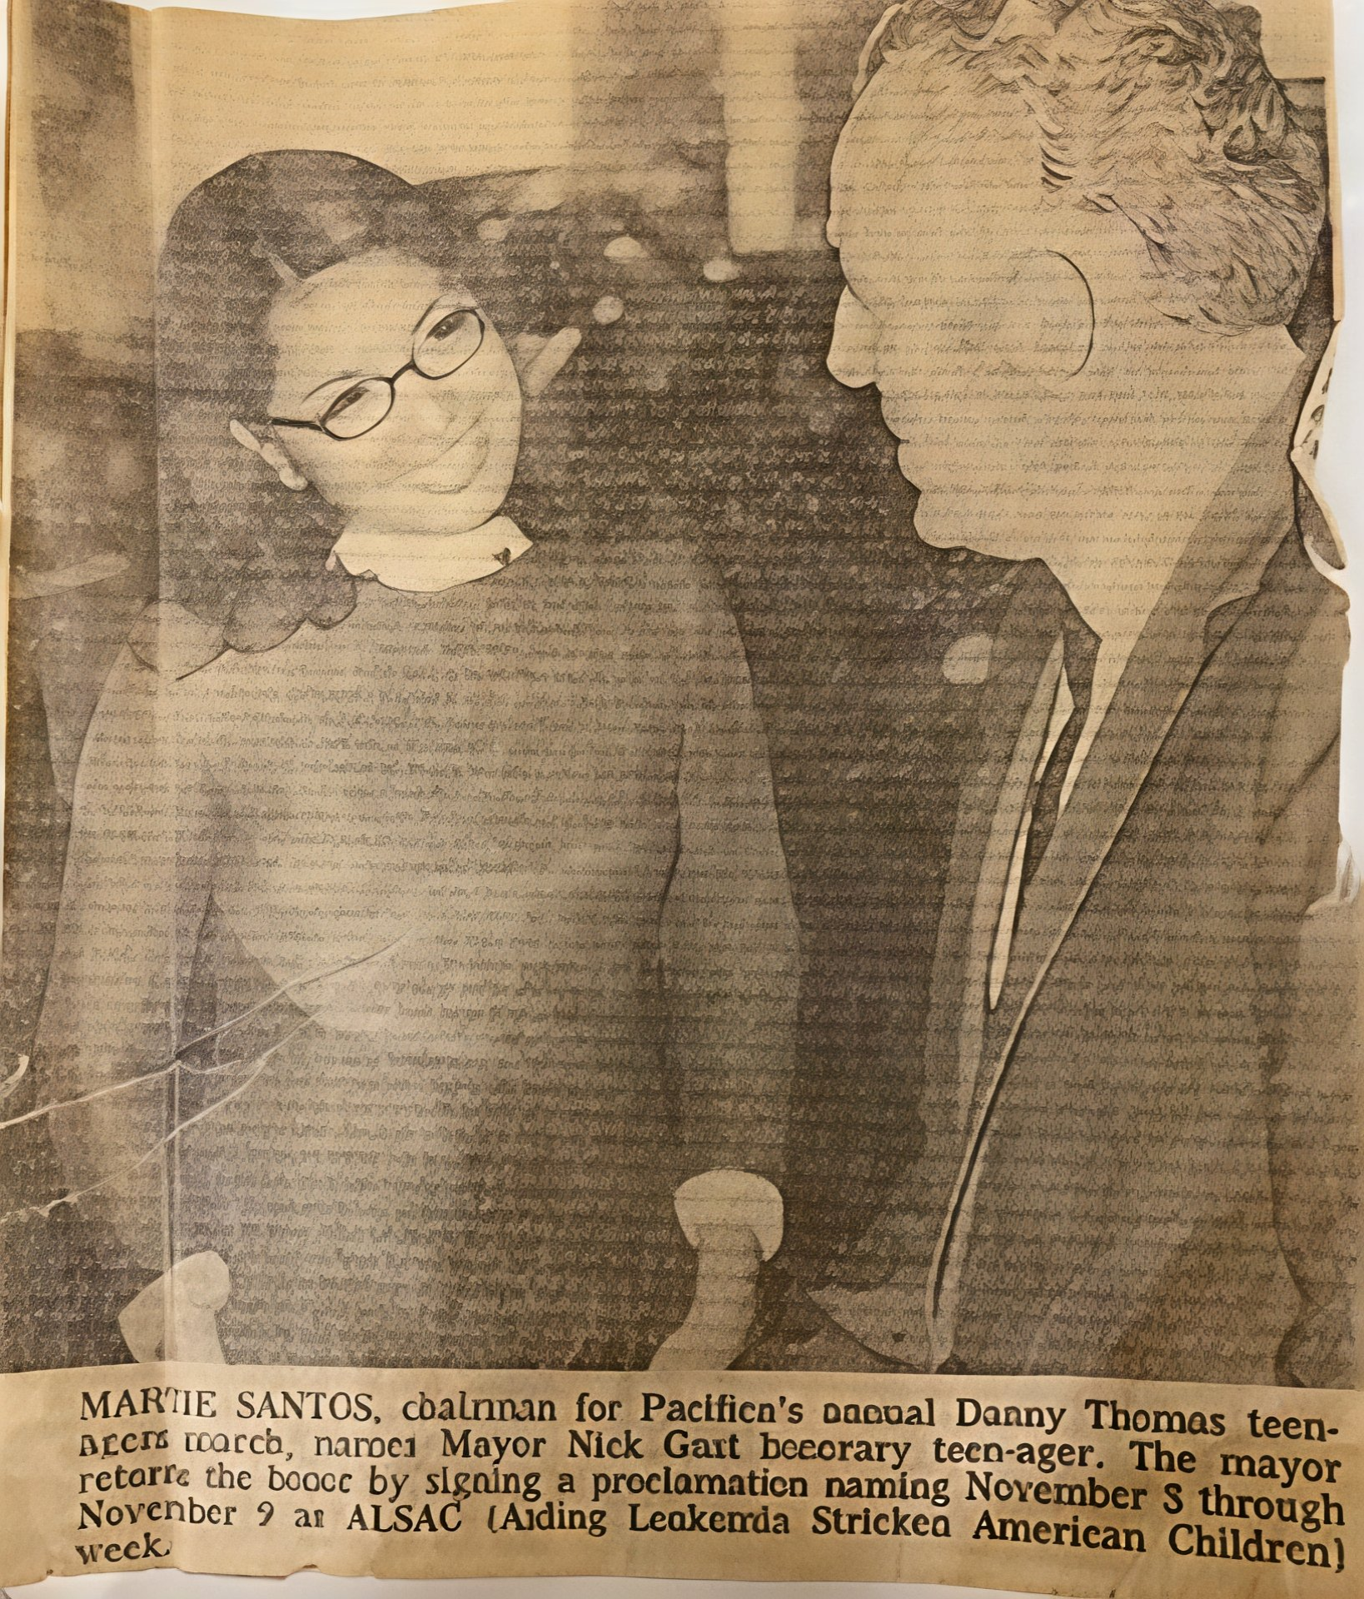
HUMANITARIAN AND ORGANIZATIONAL CONTEXT
ALSAC – Aiding Leukemia Stricken American Children St. Jude Research Hospital

Slide 20
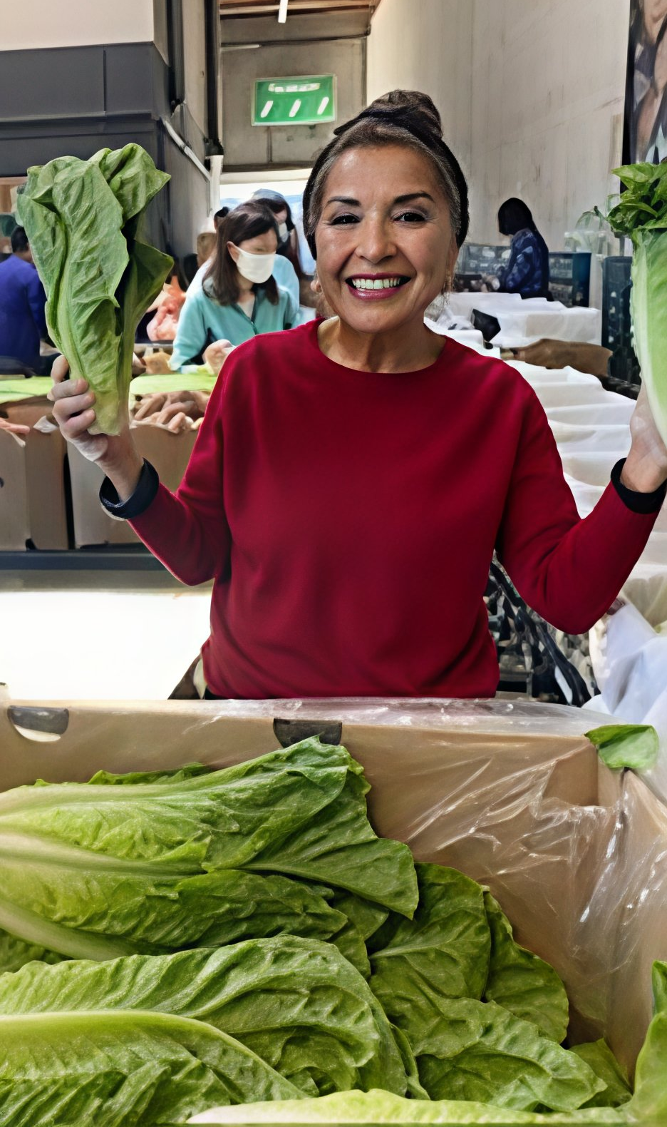
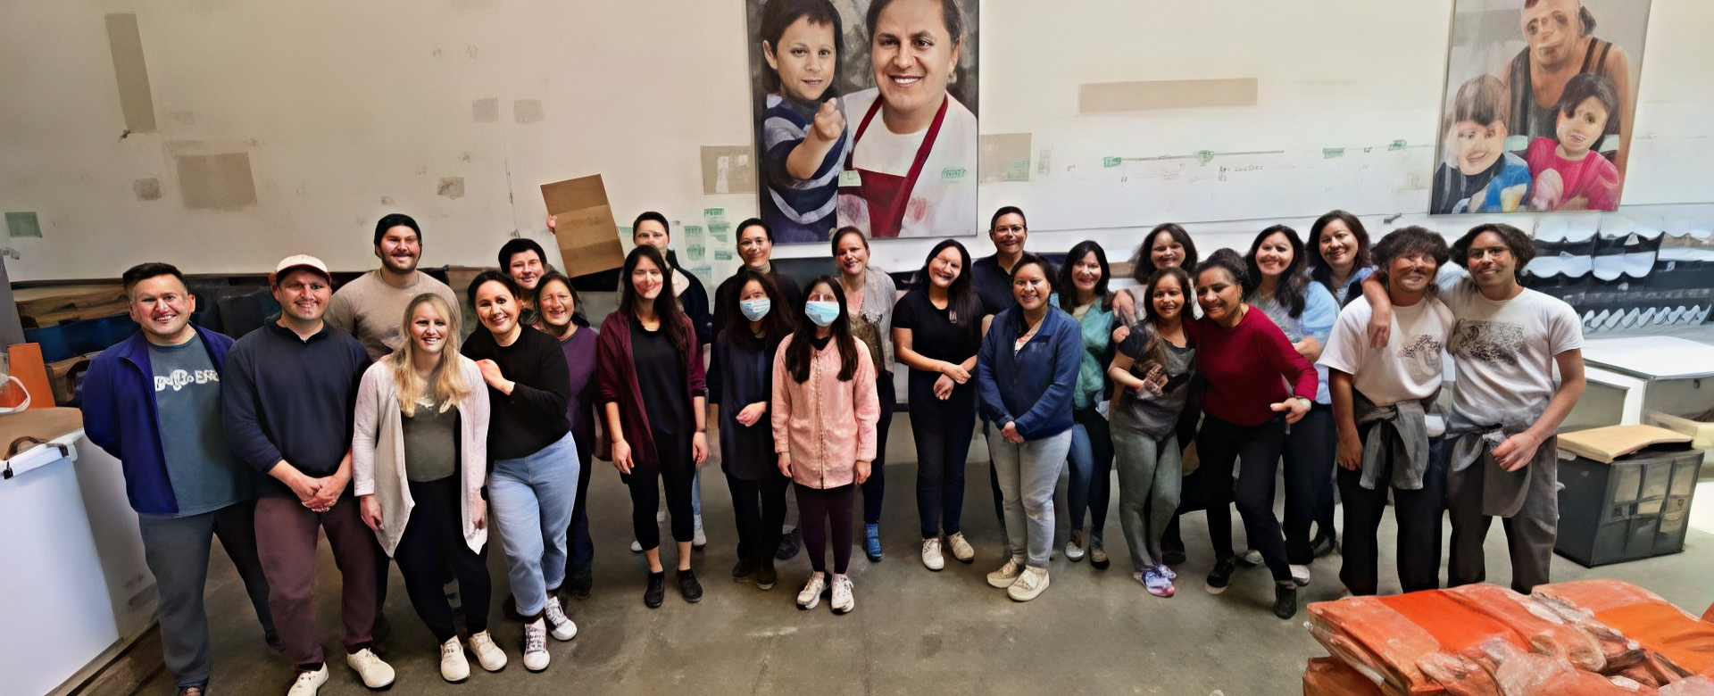
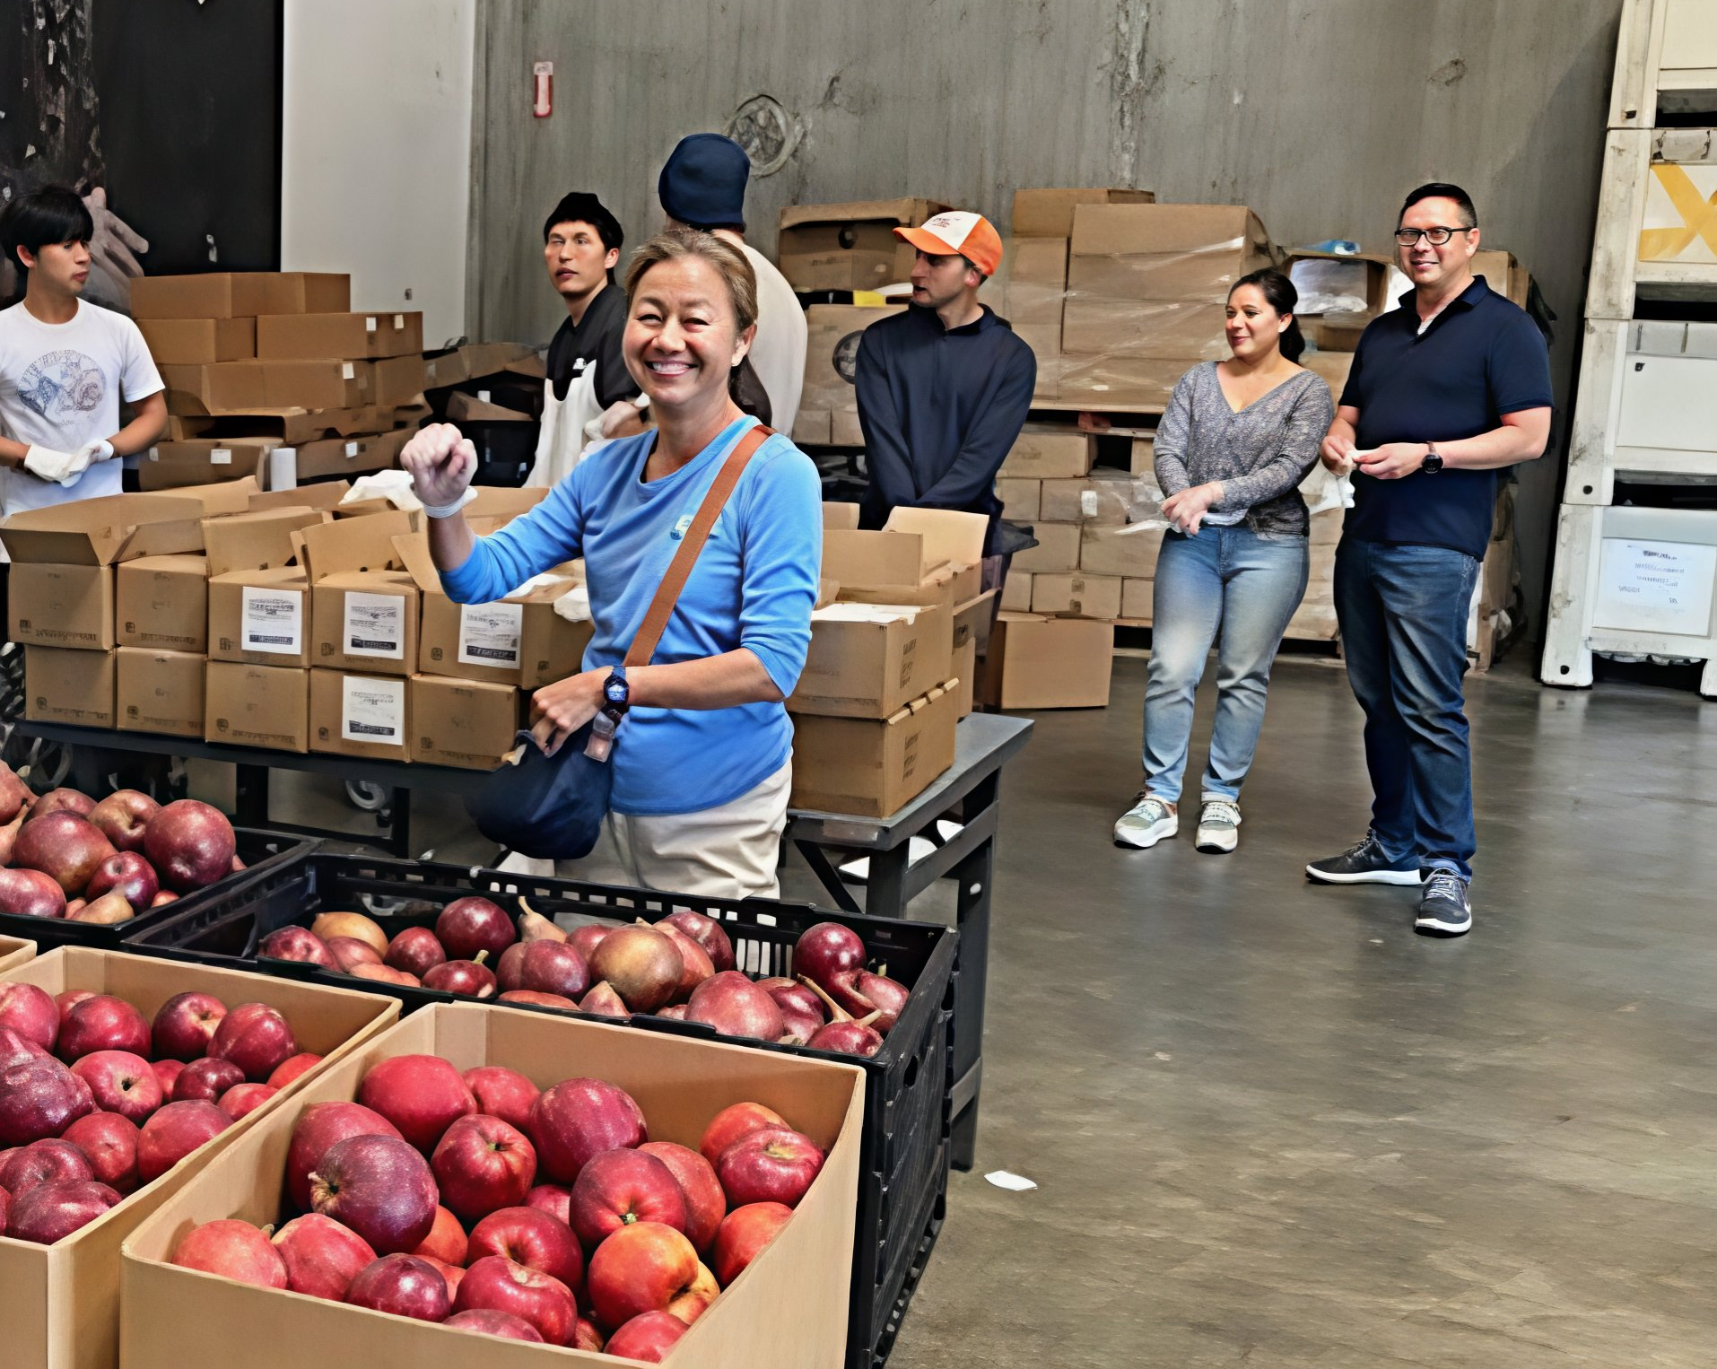
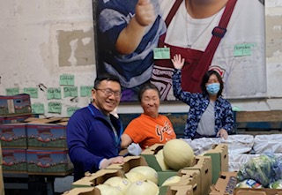
HUMANITARIAN AND ORGANIZATIONAL CONTEXT

Slide 21
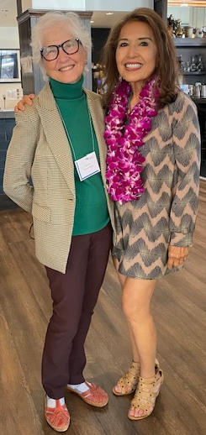
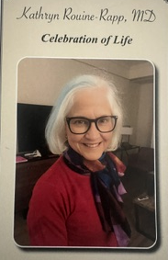
HUMANITARIAN AND ORGANIZATIONAL CONTEXT
Faculty Celebration of Life/Spousal Death Benefits

Slide 22
HUMANITARIAN AND ORGANIZATIONAL CONTEXT
From: Rapp, Joseph <Joseph.Rapp@ucsf.edu>
Date: Thu, Apr 24, 2025 at 4:09 PM
Subject: Re: Dr. Kathryn Rouine- Rapp
To: Martie Santos <martie.santos@gmail.com>
Martie,
Thank you for your note. Kathryn was a wonder in so many ways and we all miss her desperately. I remember that she admired your efficiency and expertise. I believe we met briefly years ago but could you please reintroduce yourself on Sunday?
Again, thank you for the note and supporting her effort to enrich the Department's clinical research efforts.
Joe

Slide 23
HUMANITARIAN AND ORGANIZATIONAL CONTEXT
From: Rapp, Joseph <Joseph.Rapp@ucsf.edu>
Date: Mon, Aug 18, 2025 at 9:11 AM
Subject: Kathryn’s Retirement Benefits
To: Martie Santos <martie.santos@gmail.com>
Martie,
You apparently hit the correct buttons In the retirement office last week. I just received a call saying the death benefit was mailed last Friday and they are doing the monthly payment calculation and will call me with the result when finished.
I believe that a letter detailing the delay in processing Kathryn's benefit is still appropriate. I will revise that and get it to you for review this afternoon.
Many, many thanks
Joe

Slide 24
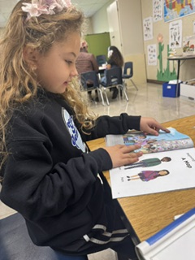
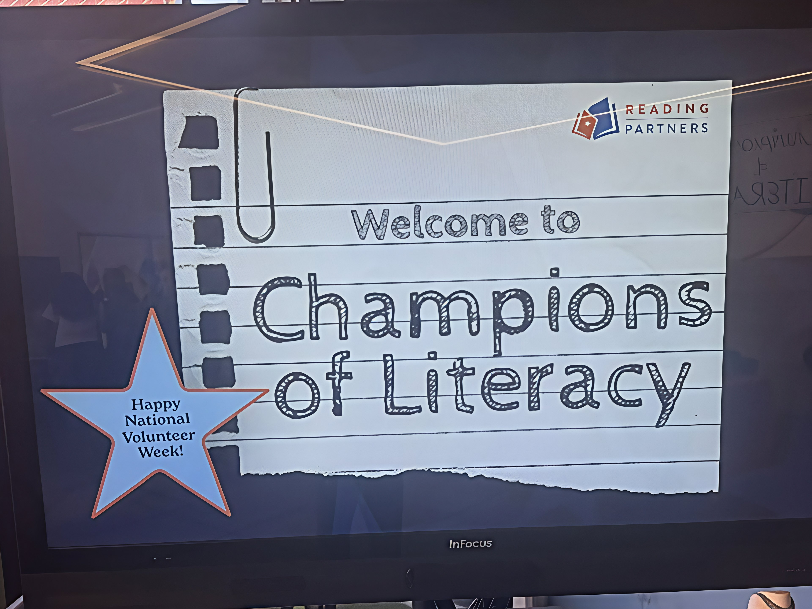
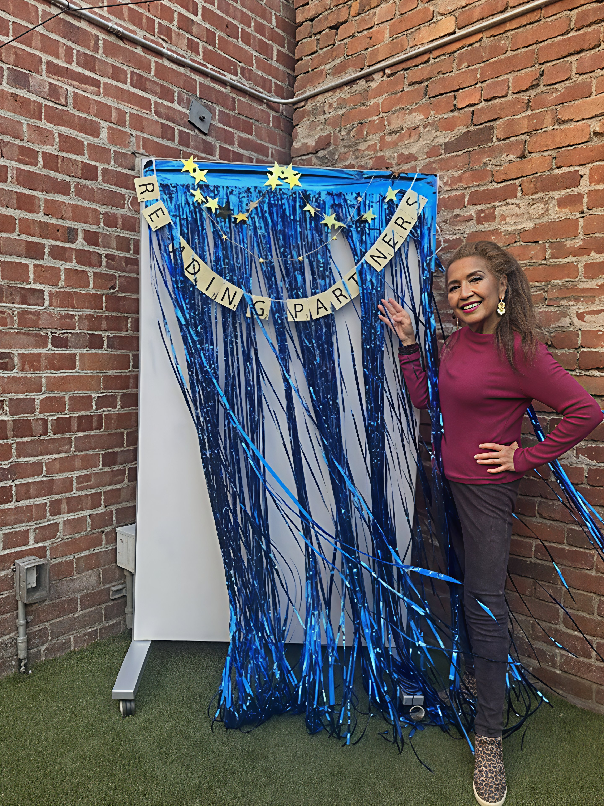
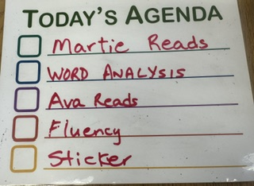
HUMANITARIAN AND ORGANIZATIONAL CONTEXT

Slide 25
THEOLOGICAL CONTEXT
Human Action in Work: It refers to the efforts made by human beings to act in accordance with their faith, often interpreted as working alongside divine action or "synergism".
Active Response: It is seen as a calling to be "doers of the word," serving and taking action, rather than just waiting for divine intervention.

Slide 26
THEOLOGICAL CONTEXT
Experiences
Patient Advocate for Chamorro Elder
Family Search
Introducing Faculty to Chamorro Cuisine via Prubechu SF
Upon processing faculty leaves (vacation, Doctors Without Borders/doctors responding to medical humanitarian emergencies) and discerning that their travels will entail passing through Guam, and with their concurrence, I arrange a meetup with family on Guam with whom they could engage in person… dining, tour, etc.)
T-Bone Near Miss

Slide 27
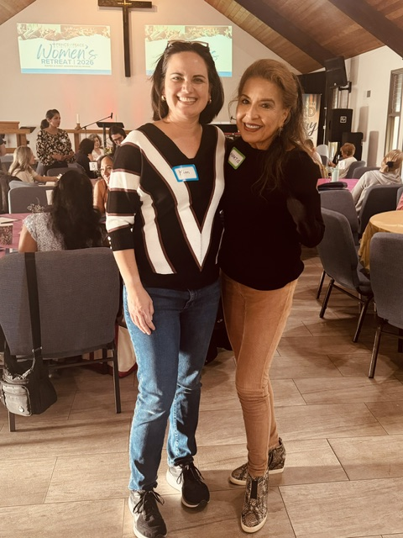
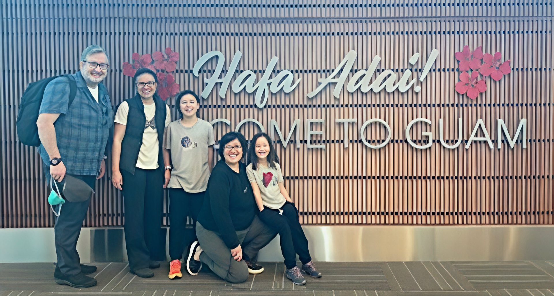
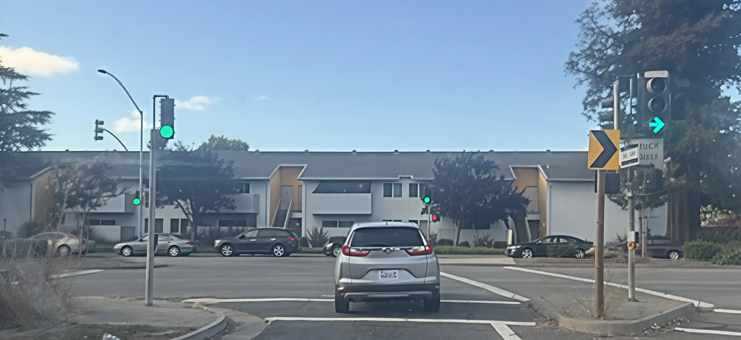
THEOLOGICAL CONTEXT

Slide 28
WHY INITIATIVE MATTERS
Career Success: It is a key trait that employers look for, leading to promotions and greater innovation.
Efficiency: When members of a group take initiative, tasks are accomplished more efficiently.
Resilience: It helps individuals overcome setbacks by encouraging a proactive, rather than passive, approach.

Slide 29
WHY HUMAN INITIATIVE MATTERS
Human initiative matters because it transforms passive observation into active creation. While systems and artificial intelligence can optimize existing processes, only human drive provides the purpose, adaptability, and curiosity needed to navigate uncharted challenges and shape our future.

Slide 30
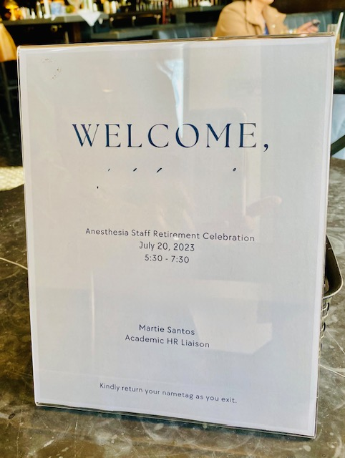
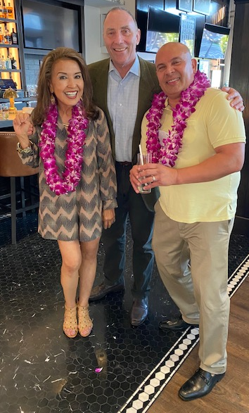
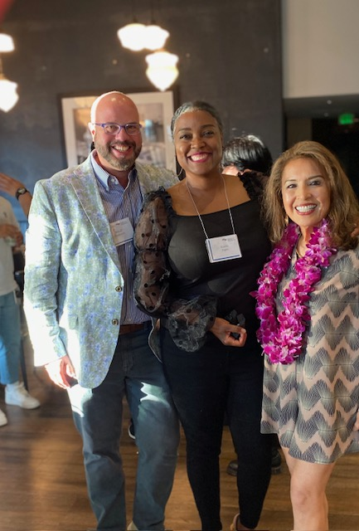
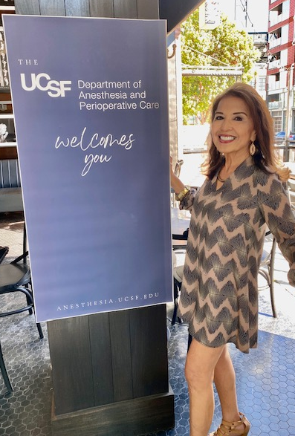
Retirement transition event

Slide 31
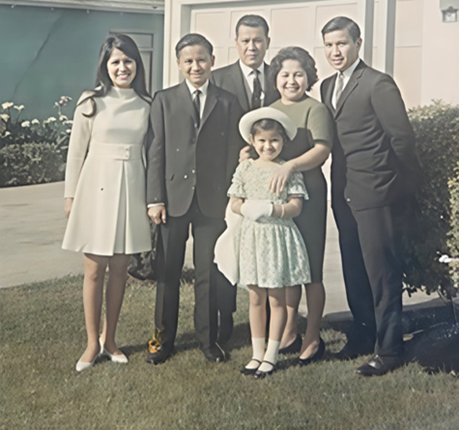
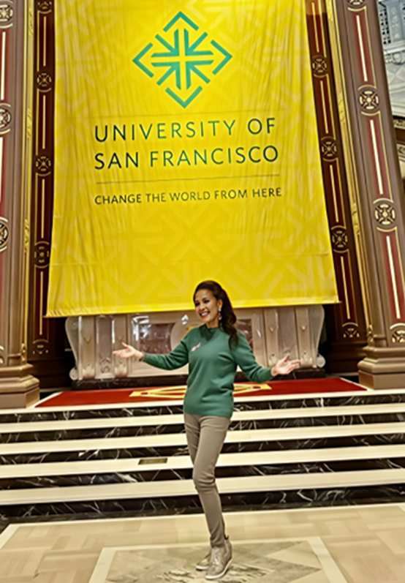
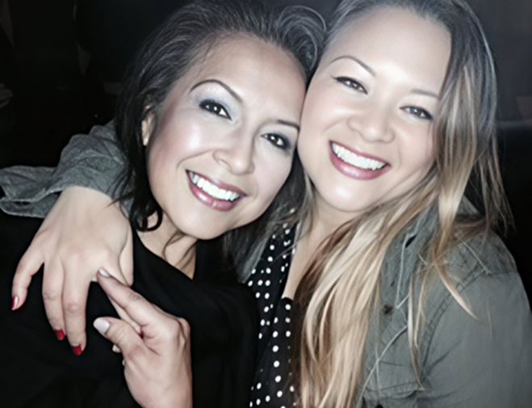
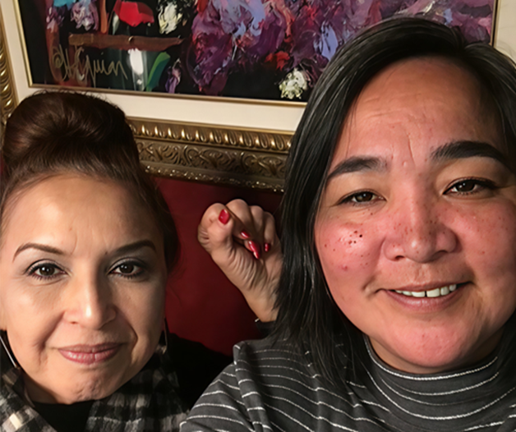
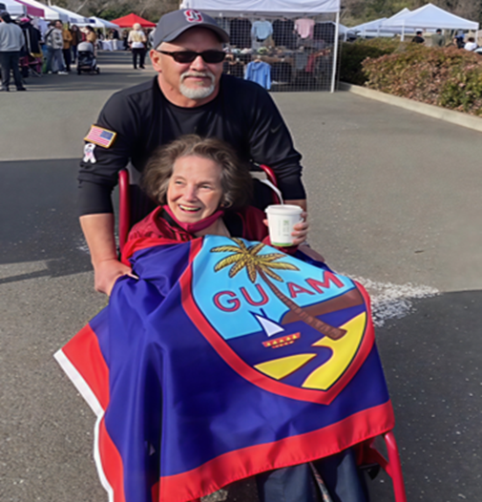
Family, education, culture and pride

Slide 32
“a-” is an “F”
From: "Steurer, Marc" <Marc.Steurer@ucsf.edu>
Date: Monday, April 24, 2023 at 1:58 PM
To: Martie Santos <SantosM@ucsf.edu>
Subject: Re: Retirement!
Hola Martie!
Awww – thank you so much for your email! It made my day
I am very happy for you to transition to the next, exciting chapter! Equally, I am personally sad to see you leave the department. It’s been both professionally and personally exceptional to work with you! Thank you for everything! (“A+” does not do it justice!)
All the very best wishes! And you know where to find me – if there ever is anything I can be of assistance.
Marc

