Slide 1
The Law Endures. Priorities Shift. Leadership Decides.

Slide 2

Laws Enforced by the EEOC
Title VII of the Civil Rights Act—(race, color, national origin, religion, sex)
Age Discrimination in Employment Act—(age 40+)
Equal Pay Act (unequal wages based on sex)
Americans with Disabilities Act
Genetic Information Nondiscrimination Act
Pregnant Workers Fairness Act—accommodation
Retaliation—is included in all the laws

Slide 3

Message #1—Do not violate the actual laws.
Supreme Court Decisions and federal laws dating back decades are still good law on the books, have not been overturned to date.

Slide 4

What EEOC Does
Investigates
Mediates
Litigates
Outreach and Technical Assistance
Reports Results to Congress/President
Congressional Budget Justification
Annual Financial Report
Annual Performance Report

Slide 5
EEOC Truths
Small, independent agency (not Cabinet level agency)
Reports directly to the White House
More work than money—always
Never enough staff to handle all the work
Must triage cases—put most focus on most meritorious and current agency priorities
Public can insist on filing

Slide 6
Priorities
Change with Administrations
Enforcement Plans—notify what the agency wants to focus on
Some things remain priorities while others do not

Slide 7
Message #2—The more things change, the more they stay the same.

Slide 8
EEOC Explore Tool
Enforcement and Litigation Statistics Link at www.eeoc.gov

Slide 9
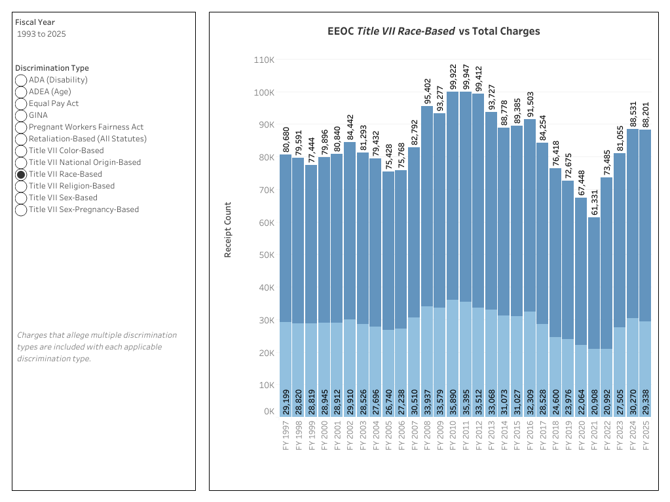
Explore Race Chart

Slide 10
Charge Receipts

Slide 11
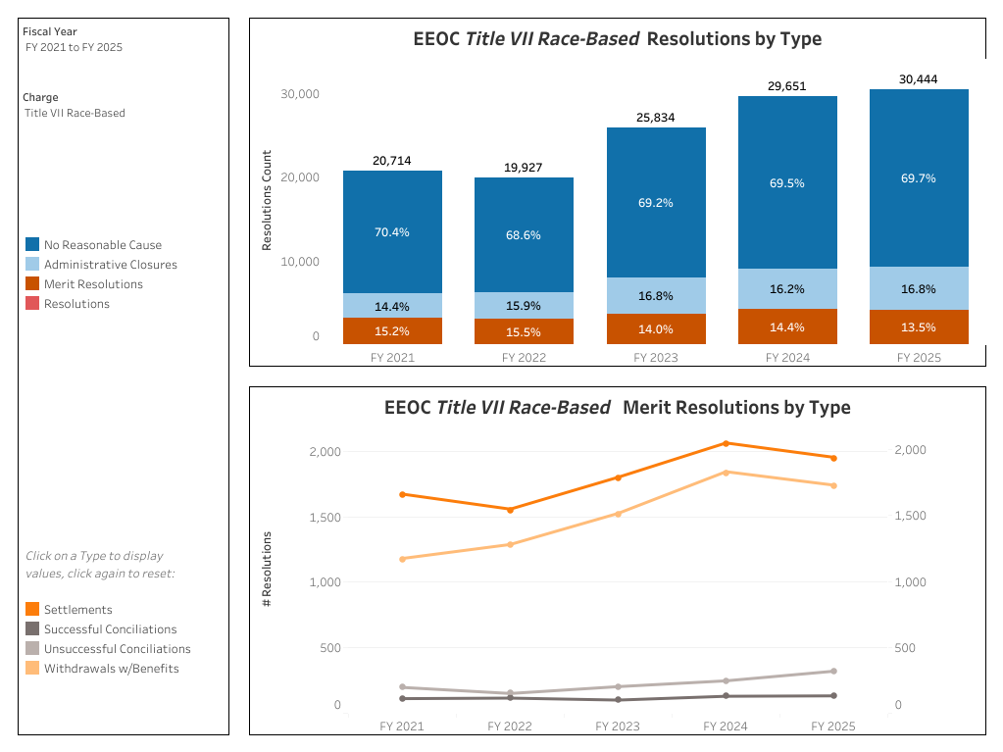
Resolutions

Slide 12
Priorities
Yesterday and Today
Broad Impact/Limited Resources
Commitment to Outreach
One EEOC-integrated efforts
Vulnerable worker protection
Retaliation aggressive enforcement
Systemic Harassment

Slide 13

Other Current Priorities
Religion Discrimination (accommodation)
Anti-American Discrimination
No Disparate Impact Investigations
No Gender Identity Cases

Slide 14
Focus and Priorities—Today—No DEI
DEI is not a law
DEI—Title VII does not have a definition of DEI
DEI guidance from EEOC says what the laws say—do not make employment decisions motivated by protected characteristics.
Started over 15 years ago as D&I
Never included “exclusion”
EEO laws make “exclusion” based on the various types of discrimination—unlawful
took on a meaning of “for people of color” or “for marginalized people”----maybe to the exclusion of other people
NEP-mentions recruitment/hiring/training opportunities etc. specifically targeted for certain groups as problematic
NEP also says that things required that have specifically to do with “diversity” quotas/metrics as problematic
Diversity, Equity and Inclusion

Slide 15
Message #3—Do not panic.
Don’t over-react; Don’t under-react
Companies are erasing all efforts, or they are not and just hoping for the best.

Slide 16

Questions for Leadership
Why did you engage in efforts to be inclusive in the first place? Was it only because the government wanted you to?
Has there been value added for your business? (variety of opinions, skills, expertise, good morale, low turnover, good reputation, etc.)
Exclusion is the problem, not inclusion.

Slide 17
Message #4—Lead regardless of changing political climates.
Be strategic, calculated and forward-thinking for business reasons, not political ones.

Slide 18

The Pendulum Swings

Slide 19
Pivot—Get Off of the Moving Pendulum for Good
Build programs that survive political cycles (e.g. open to all employees; based on documented business needs; supported by measurable business outcomes; aligns with the anti-discrimination laws)
Ultimate Goal—Have processes that are fair, transparent, consistently applied and well documented.
Self-assessment—critical component of solid leadership
What am I doing well?
What should I start doing?
What should I stop doing?

Slide 20
Re-Frame/Re-Package Efforts
Affinity Group Meetings/Activities—Don’t exclude anybody
Hiring---Recruit broadly (large universities, community colleges, rural institutions, social media platforms, etc.); ask identical interview questions; use standardized scoring; employ actual relevant and measurable qualifications necessary for the job in question; etc.
Mentoring—Don’t limit to one race/sex, open it up, matching mentor/mentee w/o protected characteristic considerations
Training—for everybody; respectful workplace behavior, preventing discrimination and harassment, effective communication
Internally track and use data to help identify potential barriers regarding compensation, hiring, discipline fairness, etc.
Transparency, Consistency, Objectivity and…..

Slide 21
Document
Clear Criteria
Objective scoring systems
SOPs
Evaluations
Qualifications Standards
Compensation Decisions
Eligibility Requirements
Communications
Results
Consistent Monitoring/Assessment

Slide 22

The Future

Slide 23

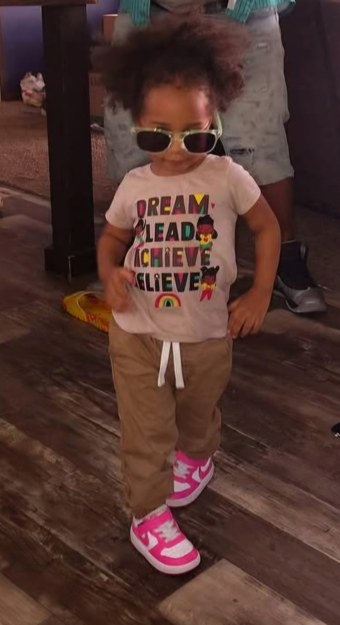
TaMeisa & Imani

Slide 24


Emotions

Slide 25

The Ask

Slide 26







The Thinkers

Slide 27

The Room

Slide 28


Perspectives #1

Slide 29
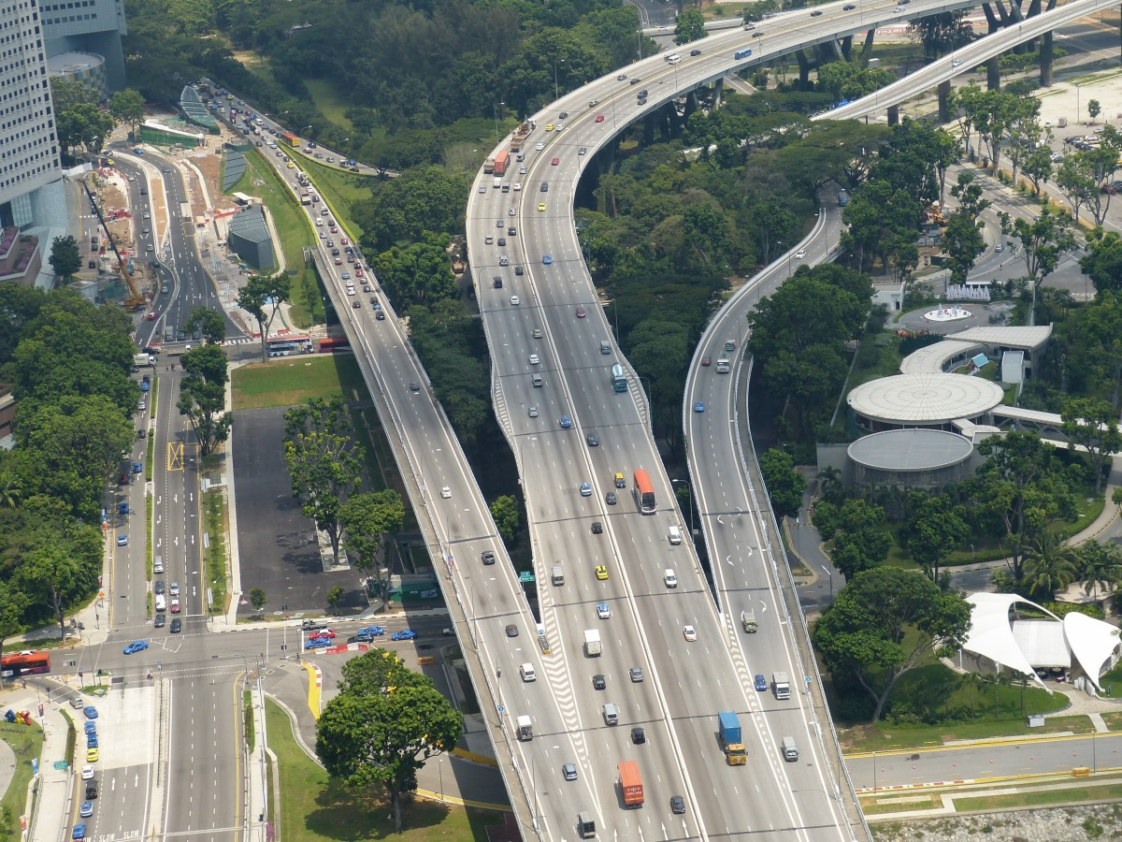
Perspectives #2

Slide 30
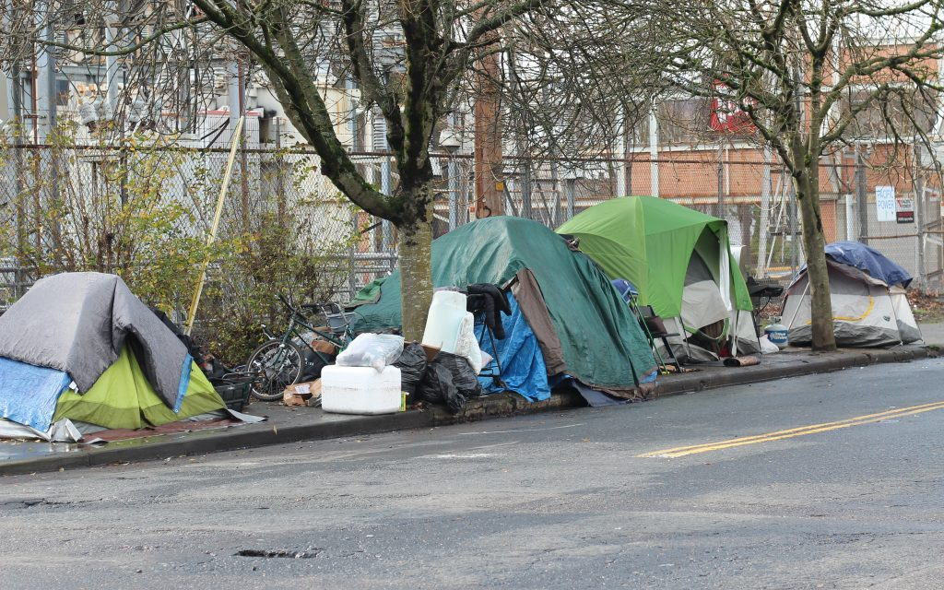

Perspectives #3

Slide 31

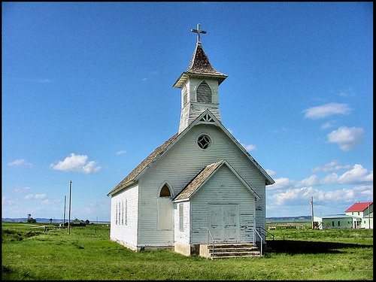
Perspectives #4

Slide 32


Solutions

Slide 33






Results

Slide 34

Value Added!

Slide 35
What are we doing?
Following the anti-discrimination laws
Realizing that we can be inclusive, get the benefit of having a variety of engagement, etc. and align with the spirit of the laws—not to the exclusion of anyone
Ensuring that as leaders, we are self-assessing consistently
Ensuring processes are fair, transparent and consistently applied
Not panicking with changing political environments
Taking it all very seriously
Giving ourselves the best shot at business prosperity
Positioning ourselves to defend our fairness/inclusion efforts
Fixing the world for our little humans

Slide 36
Final Message
Don’t Erase Inclusion
Drive, Excellence and Innovation using
Development, Experience and Integrity as staples to advance
Dialogue, Engagement, and Impact, so that ultimately, your
Decision-making, Execution and Inclusiveness not only abide by the law of the land, but also, ensures a variety of opinions, skillsets, experiences and expertise in civil and respectful workplaces for the sake of your business’ success and sustainability.

Slide 37
Cheryl Mabry, Owner
Mabrie EEO Services mabrie@eeoservices.com
240-292-9703

