Slide 1
[Your Organization] Brand Protection
Business Case for Brand Protection Management

Slide 2
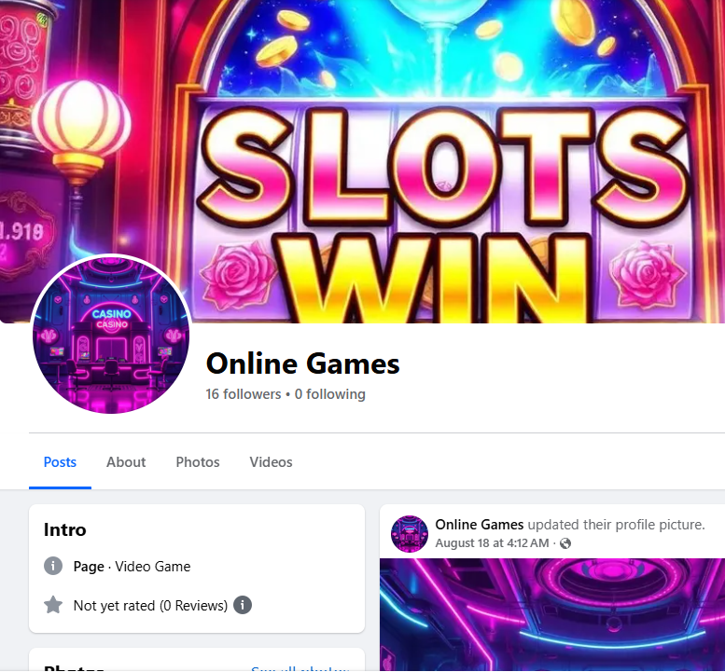
Current Brand Threat Landscape
Surge in social media brand impersonation (e.g., Facebook ads redirecting to fraudulent online gambling sites)
AI-generated fake celebrity endorsements
Unauthorized use of brand in online content

Slide 3

Business Risks
Brand dilution and erosion of consumer trust
Legal exposure from inadequate enforcement
Reputation damage via scam associations
Loss of guest loyalty and engagement
Operational disruption for marketing, legal, and security

Slide 4
Current Challenges
Lack of dedicated resources
Fragmented responsibilities and issue ownership
Slow discovery and takedown processes
Limit on FTE and overhead expense growth

Slide 5
Proposed Solution
Establish Brand Protection Manager (FTE) in conjunction with a software solution
Contract with a trusted brand protection service

Slide 6
Scope of Responsibilities
Real-time monitoring and detection
Documentation and reporting
Takedown enforcement and legal coordination
Proactive strategy development against emerging threats

Slide 7
Solution Investment
Cost estimates depend on experience, location, and service cost and/or salary research sources. The brand protection software market is large enough to be tracked and scored by Gartner.
FTE Cost: $90,000–$140,000/year
Service Partner Cost: $50,000–$300,000/year

Slide 8
Business Impact
Faster fraud detection and takedowns
Stronger legal defense and IP protection
Safeguarding guest trust and loyalty
Operational relief for internal teams

Slide 9
Recommendation
Approve dedicated brand protection resource to proactively defend [Your Organization] brand, reputation, and customer trust in an evolving threat landscape.
Alternatively, request Tribal Council or Tribal Chair approve a dedicated brand protection solution to defend and protect brand, reputation, and customer trust across all [Your Organization] business verticals.

Slide 10

Q&A / Discussion
Thank you. Open for questions and discussion.

