Slide 1

Pandemic Burnout in the Workplace

Slide 2
Objectives
Identify
Identify the signs and symptoms of Pandemic Burnout.
Know
Know the 3-pronged approach for preventing and recovering from burnout.
Learn
Learn practical strategies that you can implement everyday to keep you out of burnout so that you can feel great and create sustainable peak performance.

Slide 3
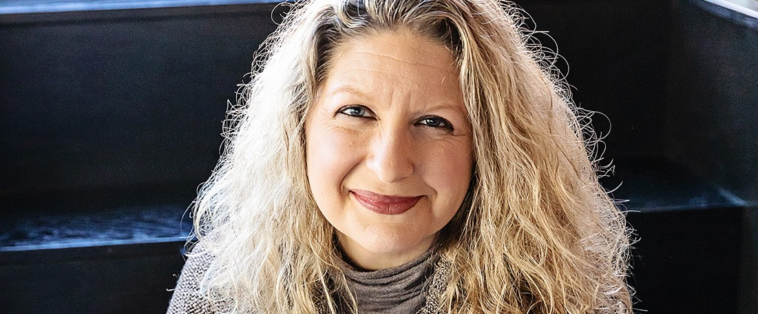
A Little About Me…..

Slide 4

Pandemic Burnout

Slide 5

What can happen?
Identity Challenges
Drop in confidence
Drop in Dopamine
Anxiety/stress
Relationship Issues
Loss of meaning and purpose/reduced feeling of accomplishment

Slide 6

Signs you may be Burnt Out
Decreased ability to concentrate
Disrupted Sleep or Need for More
Changes in appetite

Slide 7

Signs of Burn Out
Feelings of Dread
Loss of interest
Fatigue, Headaches, GI issues

Slide 8

Employee Signs of Burnout
Missed Deadlines
Increased Absenteeism
Tardiness
Poor grooming/hygiene
Decreased responsiveness
Change in attitude
Change in mood
Keeping camera off

Slide 9

So….Now What?

Slide 10
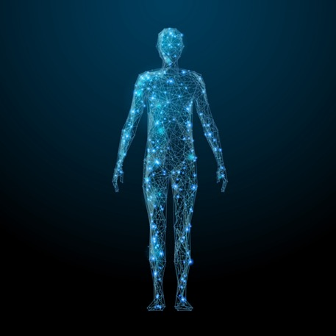
What happens to your body when you’re burnt out?

Slide 11
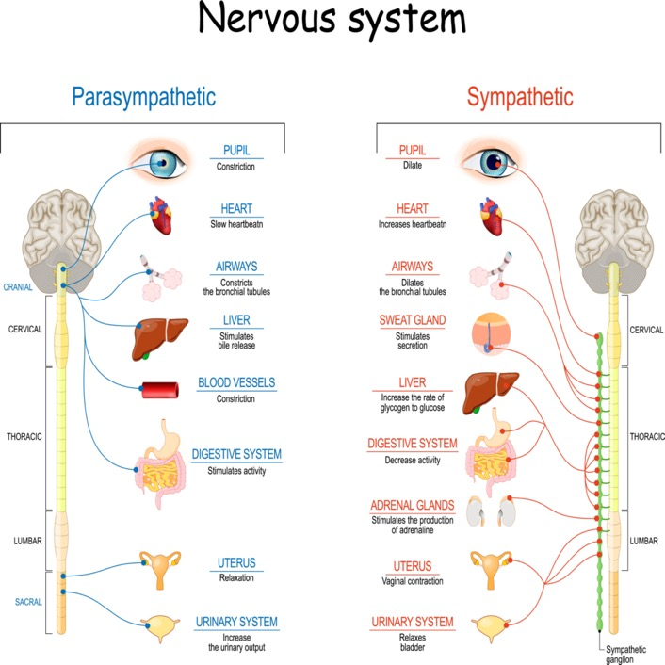

Slide 12
Prevention & Healing
Need to trigger the Parasympathetic NS, Rest & Digest
Sleep
Fresh air
Exercise
Proper nutrition
Relaxation
Make time each day to tend to your nervous system

Slide 13

Manage Your Energy

Slide 14

Mindset

Slide 15
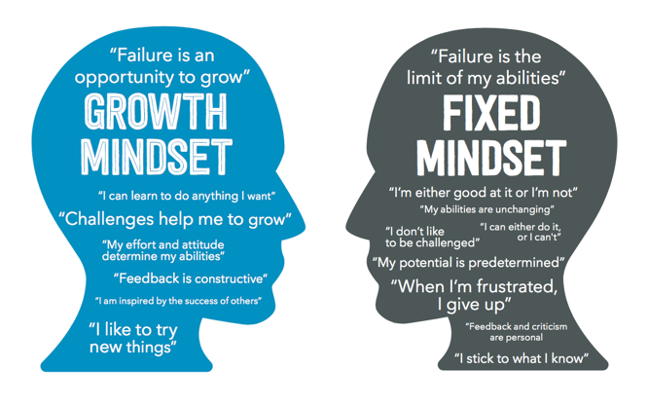
The Power of Mindset

Slide 16
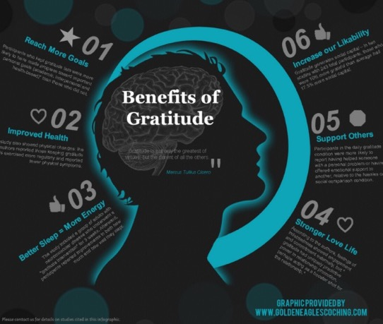
Rewire Your Brain
Change your beliefs about success and hard work
Neurons that wire together fire together
Be a Benefit Finder

Slide 17

Create Daily Success Habits
Morning SAVERS
  Silence
  Affirmations
  Visualization
  Exercise
  Reading
  Scribe (Writing)
Evening Rituals-Bookend your day

Slide 18

Success Habits
Flexible Work Schedules
Compartmentalize
BOUNDARIES
The new commute
Breaks
Schedule
Ask for help
Take Time Off

Slide 19
Next Steps
Sign up
Sign up for your Free Gift: 5 steps to Peak Performance at www.drdonnamarino.com
Email
For the first 5 people: Email Dr. Donna for a complimentary consultation on how to get more out of your career without sacrificing your personal life or burning out.

Slide 20

Contact Information
Dr. Donna Marino
donna@drdonnamarino.com
www.drdonnamarino.com
708-232-6833
Interested in contributing to the body of research on High Achievers and High Achievers Syndrome. Email me to learn more about participating in a research study this summer. It will only take about 20 minutes out of your day but will contribute to world-wide knowledge about people like you!

