Slide 1

Optional Affiliate Logo
Better Workplaces. Better World.

Slide 2

The Business of Human Potential
We’re out to build better workplaces
that will create a better world.

Slide 3
Seacoast Human Resources Association’s Mission:
To enhance the professional growth of our members by advancing the skills and competencies in the field of Human Resources through seminars, workshops, personal contacts and networking.
Notes:
Read slide – We have a powerful, purpose-driven Mission. Together we will help each other continue to grow and develop.

Slide 4
Welcome to our May Program:
Recruitment and Retention Strategies
Toni Runci
Blue Lion Inc.
Toni Runci, Human Resource Associate with Blue Lion Inc., has over 14 years of experience in HR. She received her undergraduate from SNHU in Business and her Master in Human Resources.
She is the co-founder and co-owner of BlueLion, a New England-based Human Resources Outsourcing company, which supports small businesses with all their HR needs.
Toni has experience in many different industries including non-profits, retail, construction, healthcare, automotive, and so much more. She holds a certification from both SHRM and HRCI.

Slide 5

Thanks to our Program Sponsor!
Dave Sawyer
david@saferplaces.com

Slide 6



the safer places difference
Thank you
  Not all Background Checks are Created Equally
  Safer Places is Focused on Educating our Clients
  Our Service Doesn’t End with the Background Check Report

Slide 7

Not all background checks are created equally
Where the info comes from matters……..A LOT!
We educate our clients and let them decide.
Examples:
In NH and MA, a county criminal record search is a search of just one court’s records
In NH, the State Police Offer a Statewide Search (Notary not required)
In MA, CORI Provides a Statewide Search (Client enrollment required)
We Recommend Searching Each State/County Where Applicant has Resided for Past 10 Years
Add a Multi-Jurisdictional Criminal record Database Search
Search Aliases / AKA’s etc.

Slide 8

Not all background checks are created equally
What Else Should be Included?
Federal Criminal Records
Social Media Searches
Driving Records / License Verification
Employment Verifications
Education Verification
Drug Tests
Credit Report
Industry Specific Searches (Medical, Driving, etc.)
And more……………
CUSTOMIZATION (for each Position)is the Key
sssssssssssssssssssssssssssssssssssssssssssssss

Slide 9

Not all background checks are created equally
Now Offering Continuous Monitoring in Three Areas
Driving Records
Social Media
Criminal
ssssssssssssssssssssssssssssssssssssssssssss

Slide 10

Not all background checks are created equally
Service Before & After the Background Check
Integration with your ATS
State Specific Guide to Background Screening Laws
Help with Applying the Results to Your Hiring Criteria
Individualized Assessments
Adverse Action
Client Education Never Stops!
Always Happy to Chat
508-947-0600

Slide 11
SHRA Scholarships of up to $1,000 are available for eligible members!
Advancing your HR Education? Attending an HR Conference? SHRM & SHRA Membership fees?
Scholarship application window: March 1 – March 31, 2023
Questions?
Deb Donlick, SHRM-CP at debdonlick@comcast.net
Lauren Nuzzi, SHRM-CP at lnuzzi@communitypartnersnh.org
Notes:
Advancing your HR Education? Attending an HR Conference? SHRM & SHRA Membership fees?
SHRA Scholarships of up to $1,000 are available for eligible members! (check SHRA’s website for details)
Scholarships are awarded in the Fall and in the Spring.

Slide 12


Slide 13


SHRM Membership Renewals
SHRA Corporate memberships are available! Up to 5 members per company. Develop your inhouse HR talent by signing them up for SHRA membership benefits.
Select SHRA as your Primary Chapter so can we can continue to grow and contribute more to our HR Community.
SHRA Chapter # is 451
Notes:
This is really important as SHRA receives money for dual membership in both SHRM and SHRA. SHRM membership is valuable in that you have access to lots of resources, templates, and research. SHRM gives us back money for dual members as well, which helps our chapter too.
Corporate memberships are only $200! That’s a savings of $100.

Slide 14
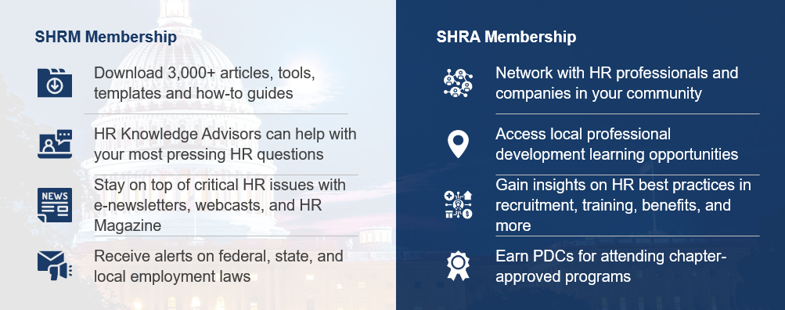
SHRM and SHRA are Better Together
JOIN OR RENEW TODAY at SHRM.ORG/JOIN-NOW
Notes:
Speaking of dual membership, here are some of the benefits of dual membership!

Slide 15


Membership
SHRM Knowledge Center
Phone:
(800) 283-7476 (US)
(703) 548-3440 (International)
Rely on a network of SHRM-certified professionals to get direct and specific answers to your toughest HR questions.
Contact HR Knowledge Advisors via email, phone or live chat.
Mon. – Fri. 8:30 am – 8:00 pm ET
Online:
shrm.org/hrhelp

Slide 16



Monthly Drawing for
SHRM-Approved Educational Books!
Winners to be announced in this week’s e-blast
Winners will be contacted by our Certification Committee
Winners can choose a book from the SHRM-approved reading list
Notes:
Winners will be contacted by a member of the Certification Committee regarding next steps. You can earn certification credits by reading SHRM approved books!

Slide 17

SHRA Programming & Survey
Your feedback is a gift!
Get maximum value from your SHRA membership.
Tell us what you think!
Share your programming recommendations to help us continue to provide relevant, timely updates and education.
Watch your email for survey and program credit information!
Return your survey & be entered to win a gift card!

Slide 18

2023 SHRA Officer Election Results

Slide 19

2023 SHRA Officer Election Results
Vice President: Christi Green
Treasurer: Regina Parker
Secretary: Jenn Horton

Slide 20
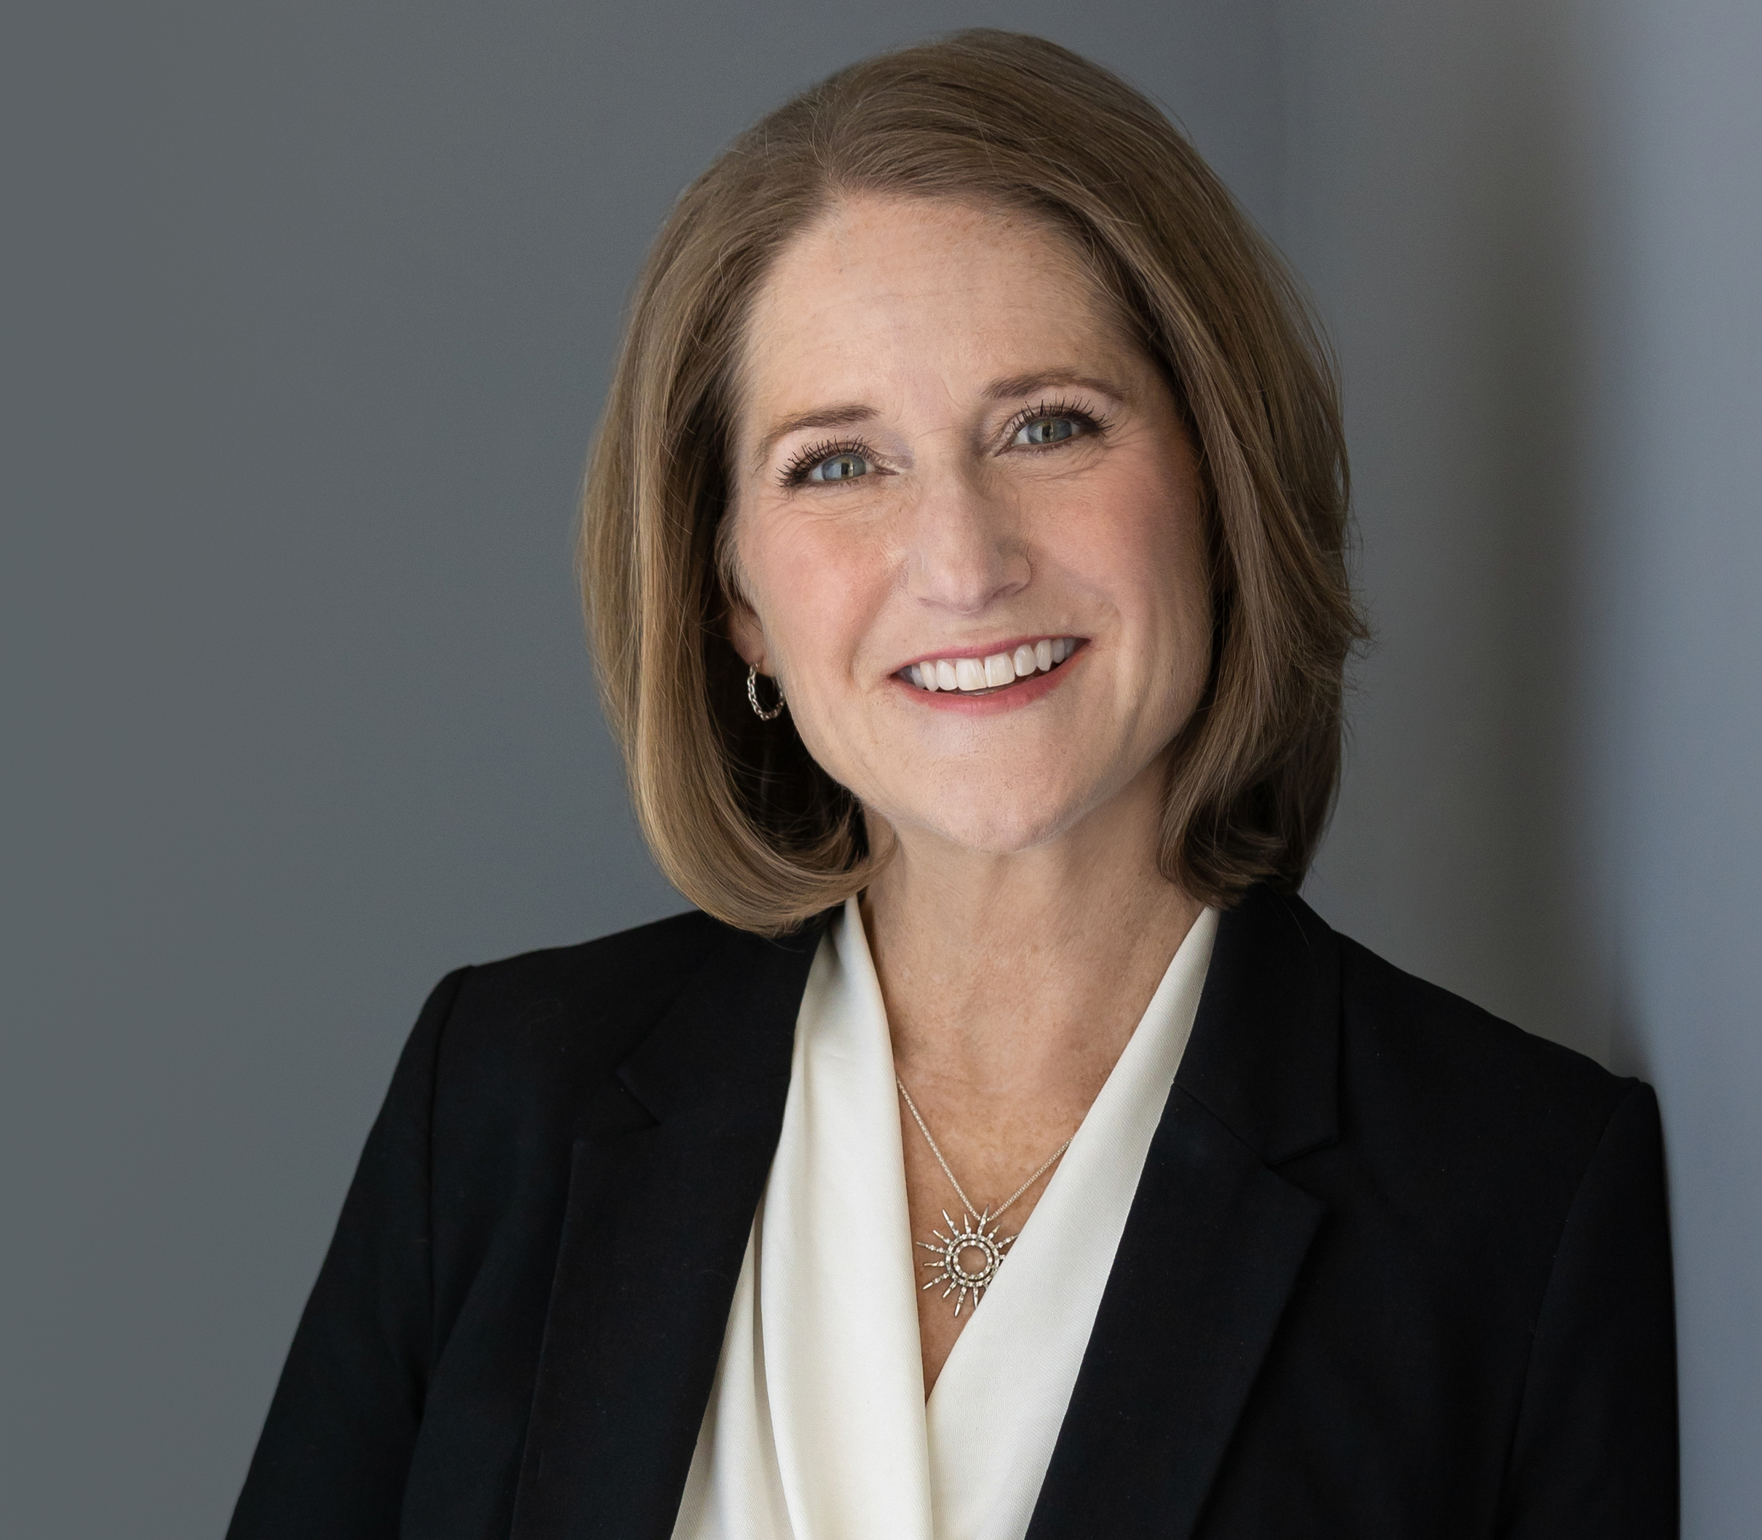
More About Christi
Christi Green is a Registered Nurse turned Human Resources professional who enjoys helping organizations enhance their ability to support their PEOPLE. With 20+ years in HR, Christi is an empathetic leader advising and coaching leaders and teams and managing major organizational and strategic change. Christi started her own HR and Leadership Consulting firm in 2022, Christi Green Consulting, LLC.

Slide 21

Interested in becoming more involved with SHRA?
We’d love to talk with you about our current Volunteer positions!
Assistant Treasurer
College Relations
Workforce Readiness
Membership
Contact Daniela Bellitta-O’Neill at d.oneill@fedex.com

Slide 22

New England Weather Alert!
Winter programs may be affected by inclement weather.
In person meetings will be cancelled if Portsmouth Schools are closed.

Slide 23
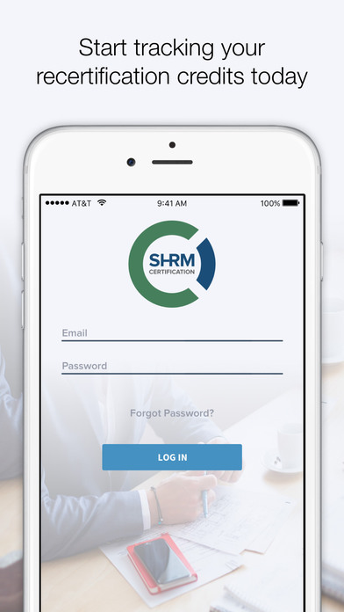
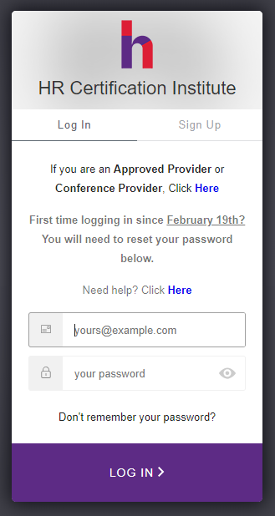
Recertification Credits
SHRM: 23-TN74E
HRCI: 628311
2.00 Credit Hours
Notes:
Take a picture of this slide if you want. Don’t forget your certification credits!

Slide 24
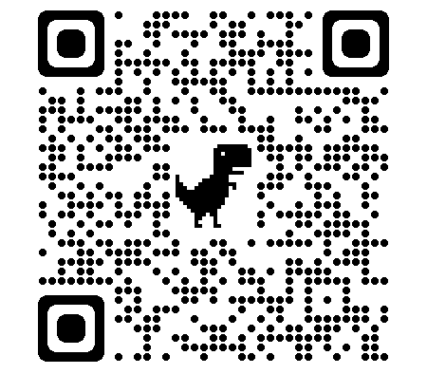
2023 Officer Election
We are holding the 2023 election for SHRA officers!
Scan image below to get to the SHRA 2023 Officer Election page.
Please note that you will need to log into the portal in order to vote.
Notes:
Christi Green has volunteered to take on the Vice President role. Our incumbent Treasurer and Secretary, Regina Parker and Jenn Horton, would like to continue in their roles for another two years and per our by-laws, need to be voted in by the members.
If you could please take 30 seconds to complete this online ballot and either select one of the candidates or write in a candidate of your choice, it would be greatly appreciated. Please keep in mind, only active SHRA members can vote and only one vote per member, per role. You will need to be logged into SHRA in order to vote

Slide 25
MAY PROGRAM REMINDER
Recruitment and Retention Strategies
Our Speaker
Toni Runci
Human Resource Associate, Blue Lion Inc.
During this session, we will discuss methods to increase your social media presence to brand, and attract new talent, engage potential talent during the interview process, wowing while onboarding, and beef up those company benefits.

Slide 26
2023 Virtual Silent Auction Now
LIVE
SHRA’s Annual Fundraiser to benefit SHRM Foundation
www.32auctions.com
Bid Now! Bid Often! Bidding Open Through May!
Still have items to donate?
Contact Paul Neve, SHRM Foundation Director paulneve115@gmail.com
Winners will be announced during the SHRA Member Appreciation Event in June!
Notes:
First off, we would love to have some donations from our members for the auction. Please contact Paul Neve for more information.
You will be able to bid on items all month long – bid high and bid often! Credit card and Paypal will be the payment methods available. You will receive notifications when you are outbid. Auction will close at 11:59pm on May 31st.
Keep an eye out for email blasts with ‘Item of the Week’ and ‘New Items’
All proceeds go to the SHRM Foundation. For more information on current SHRM Foundation initiatives, go to https://www.shrm.org/foundation/pages/default.aspx

Slide 27
SAVE THE DATE
June 8, 2023, 5:00pm – 7:00pm
SHRA Membership Appreciation
FREE FOR MEMBERS
Pavilion at Wentworth by the Sea Golf Club
588 Wentworth Road
Newcastle, NH 03854
Details Coming Soon…
Notes:
Seacoast Human Resources Association is holding its annual Membership Appreciation Event on June 8th at the Pavilion at the Wentworth by the Sea Golf Club.

Slide 28








SHRA MEMBERSHIP APPRECIATION SPONSORS
Notes:
Seacoast Human Resources Association is holding its annual Membership Appreciation Event on June 8th at the Pavilion at the Wentworth by the Sea Golf Club.

Slide 29
SPONSORSHIP OPPORTUNITIES
SHRA Membership Appreciation Event
GOLD $500 | SILVER $250 | RAFFLE
Gold sponsors are given 5 minutes to speak about their organization at the event. We will provide a table if you wish to provide a banner/swag and written materials. Gold sponsors may have up to 2 people attend the event. All sponsors will be listed on our website by category and be included in all notices to the full membership about the event. | Silver sponsors may have 1 person attend the event. Silver sponsor names will be announced by SHRA’s President at the Event. All sponsors will be listed on our website by category and be included in all notices to the full membership about the event. | Raffle sponsors provide a raffle prize of $100 or more in value to be raffled at the Event. Tables are provided for the raffle prizes with the name of the donor to be viewed by the members in attendance. Prizes will be raffled off during the event. Where possible, donors may be invited to draw the raffle ticket for their donation. All sponsors will be listed on our website by category and be included in all notices to the full membership about the event.

Slide 30

SHRA’s Spring Community Sponsor
Karen Livernois
NH CYCC Chair

Slide 31



Slide 32
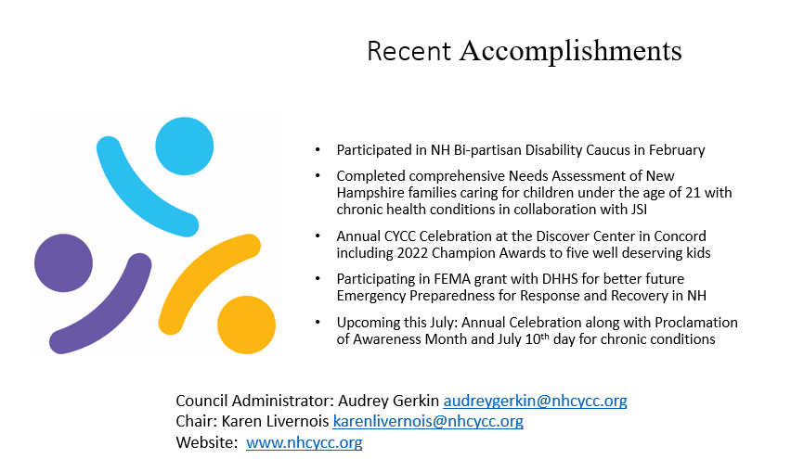

Slide 33
Welcome to our May Program:
Recruitment and Retention Strategies
Toni Runci
Blue Lion Inc.
Toni Runci, Human Resource Associate with Blue Lion Inc., has over 14 years of experience in HR. She received her undergraduate from SNHU in Business and her Master in Human Resources.
She is the co-founder and co-owner of BlueLion, a New England-based Human Resources Outsourcing company, which supports small businesses with all their HR needs.
Toni has experience in many different industries including non-profits, retail, construction, healthcare, automotive, and so much more. She holds a certification from both SHRM and HRCI.

